Slide 1
What do (and don’t) we know about the global energy system at net zero?
Jorge Blazquez
Senior Advisor

Slide 2
Index
Housekeeping: What is the bp Energy Outlook?
What do (and don’t) we know about the global energy system at net zero?

Slide 3
Three scenarios to explore the energy transition…
CO₂ emissions from energy use
Gt of CO₂

Slide 4
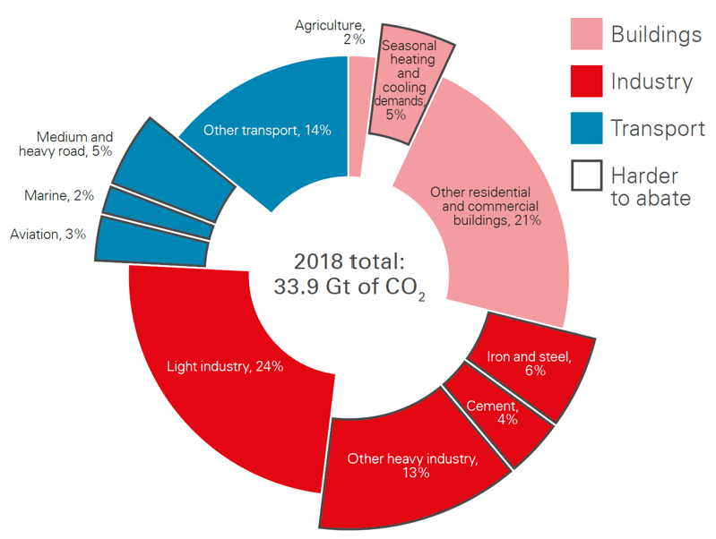
Carbon emissions from energy use…
Global GHG emissions
Carbon emissions from energy use, 2018
Gt of CO₂e

Slide 5
Index
What is the bp Energy Outlook?
What do (and don’t) we know about the global energy system at net zero?

Slide 6
IPCC Scenarios
Carbon emissions from energy use
Gt of CO₂

Slide 7
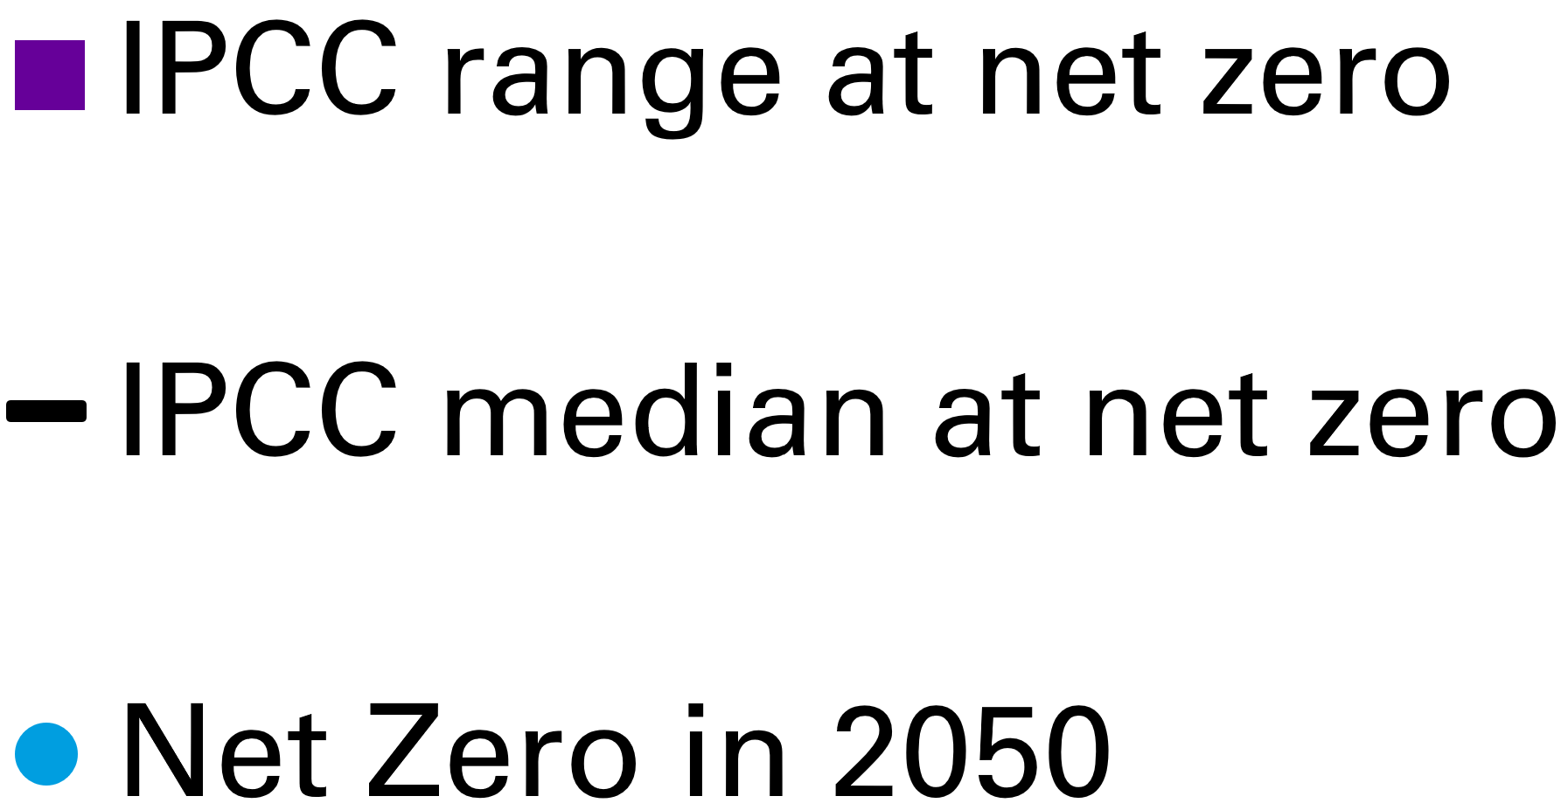
Electrifying the world
Shares of electricity, wind and solar in IPCC scenarios and Net Zero

Slide 8
Electrifying the world
Shares of electricity, wind and solar in IPCC scenarios and Net Zero

Slide 9
Increasing role for hydrogen…
Hydrogen in IPCC scenarios and Net Zero
Share of total final consumption
By sector
By type
Net Zero
in 2050

Slide 10
Production of hydrogen
Annual average increase in wind and solar capacity
GW

Slide 11
Production of hydrogen
Annual average increase in wind and solar capacity
GW

Slide 12
Increasing role for hydrogen…
Hydrogen in IPCC scenarios and Net Zero
Share of total final consumption
By sector
By type
Net Zero
in 2050
Notes:
.

Slide 13
Increasing role for hydrogen…and bioenergy
Hydrogen in IPCC scenarios and Net Zero
Bioenergy in IPCC scenarios and Net Zero
Share of total final consumption
Share of primary energy
By sector
By type
By sector
By type
Net Zero
in 2050
Net Zero
in 2050

Slide 14
What role for natural gas…
Natural gas consumption in IPCC scenarios and Net Zero
Share of primary energy

Slide 15
What role for natural gas…and oil?
Natural gas consumption in IPCC scenarios and Net Zero
Oil consumption in IPCC scenarios and Net Zero
Share of primary energy
Share of primary energy

Slide 16
Significant investment in new oil and natural gas…
Consumption and production of oil
Consumption and production of natural gas
Mb/d
Bcm

Slide 17
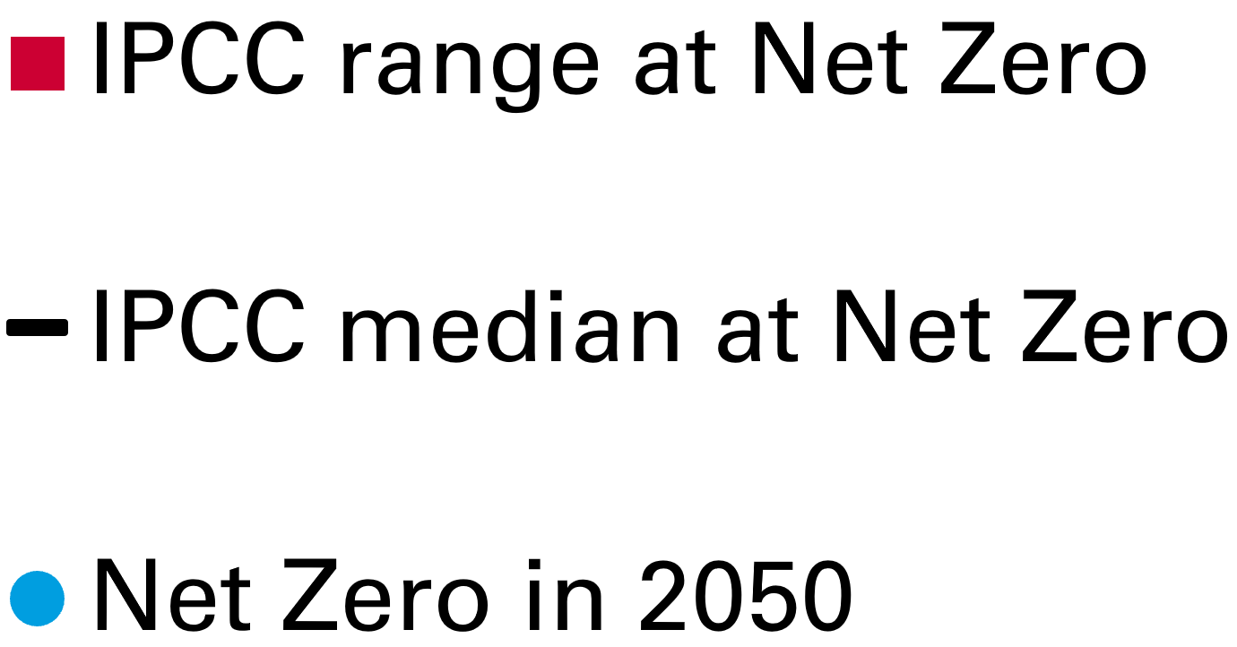
Importance of CCUS…
Carbon captured in IPCC scenarios and Net Zero
Gt of CO₂

Slide 18
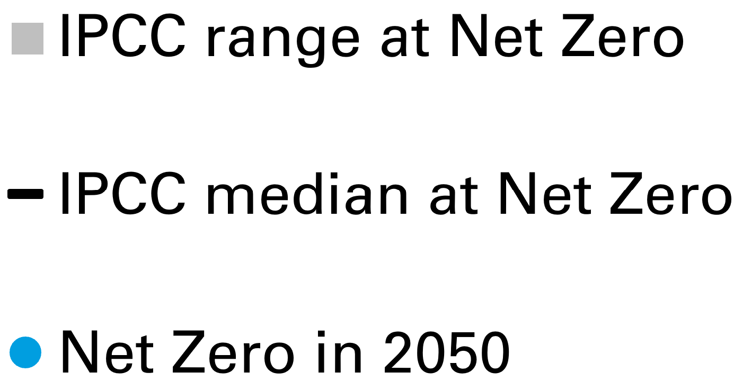
Importance of CCUS…
Carbon captured in IPCC scenarios and Net Zero
Gt of CO₂

Slide 19
Importance of CCUS…and natural climate solutions
Carbon captured in IPCC scenarios and Net Zero
Gt of CO₂

