Slide 1
Africa’s urbanization and the myth about de-urbanization: The case of Ghana
George Owusu (PhD)
Institute of Statistical, Social & Economic Research (ISSER)/Centre for Urban Management Studies (CUMS)
University of Ghana

Slide 2
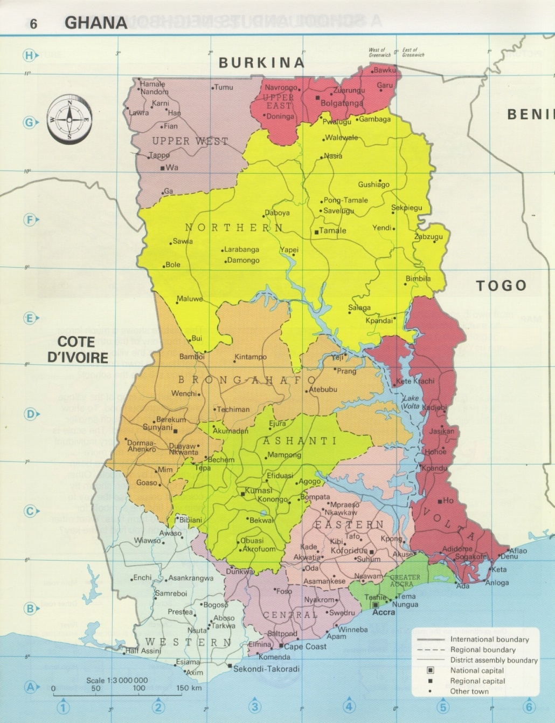
Introduction
Ghana: Location and Politico-administrative Regions
Estimated total population of 30.4 million (2019), with about 57% estimated to be urbanized and about (annual growth rate of about 3.7% (GSS 2019; World Bank 2015)
Rapid urbanization characterized by skewed distribution of urban population, preference for large cities and towns.
Main cities: Accra and Kumasi (million plus cities), Sekondi-Takoradi (4); Tamale and Tema.
Regional disparities in level of urbanization: north-south divide reflecting level of development

Slide 3
Introduction
The notion of rapid urbanization occurring in Africa has been questioned in recent years (Potts, 2009, 2012).
urban growth rates in many Sub-Saharan African countries have slowed and recent censuses show that most city growth rates are around or below the national rates.

Slide 4
Introduction
The demographic shift of population from rural to urban (urbanization) is slow or stagnating in most sub-Saharan African countries with varying experiences across countries:
some demonstrating counter-urbanization (e.g., Zambia, Cote d’Ivoire and Mali)
some having weak city in-migration (e.g., Ghana, Benin and Mozambique)
few countries have experienced high net in-migration (e.g., Tanzania, Kenya and Niger)
Is this really the case, and are Ghanaian cities experiencing weak city in-migration?

Slide 5
Urbanization in Ghana
Since formal census was introduced, Ghana’s level of urbanization has been on the increase: from 7.8 (1921), 23.1% (1960) to 57% in 2018. However, few centres dominate this urban concentration (GSS 2013).
Urbanization in Ghana represents a major redistribution of the population with preference for the very large cities and metropolitan areas.
The recency and speed of the process have significant impact on development: Ghanaian cities lack required facilities and infrastructure.
Cities are plagued by environmental problems (mainly poor sanitation/sewage, high levels of pollution); socio-economic challenges (unemployment, crime, violence, poor/inadequate housing, poverty, etc)

Slide 6
Ghana: Urbanization Trends and Projections, 1921-2060
Source: Derived from MLGRD/GoG, 2010; GSS, 2013; UNDESA, 2014 (NDPC, 2016)

Slide 7
Proportion urban and annual growth rate by Region 1960-2010
Region | Urban Proportion |  |  |  |  | Growth rate
 | 1960 | 1970 | 1984 | 2000 | 2010 | 1960/ 1970 | 1970/ 1984 | 1984/ 2000 | 2000/2010
All Regions | 23.1 | 28.9 | 32.0 | 43.8 | 50.9 | 4.7 | 3.3 | 4.6 | 4.2
Western | 24.7 | 26.9 | 22.6 | 36.3 | 42.4 | 2.9 | 1.7 | 6.1 | 3.7
Central | 28.0 | 29.1 | 28.8 | 37.5 | 42.1 | 2.1 | 1.7 | 3.7 | 3.2
Gt. Accra | 72.6 | 85.3 | 83.0 | 87.7 | 90.5 | 6.1 | 3.5 | 4.8 | 4.4
Volta | 13.1 | 16.0 | 20.5 | 27.0 | 33.7 | 3.9 | 3.5 | 3.6 | 3.9
Eastern | 21.1 | 24.6 | 27.7 | 34.6 | 43.4 | 3.4 | 2.9 | 2.8 | 3.3
Ashanti | 25.0 | 29.7 | 32.5 | 51.3 | 60.6 | 4.6 | 3.1 | 6.3 | 4.7
Brong-Ahafo | 15.6 | 22.1 | 26.6 | 37.4 | 44.5 | 6.1 | 4.6 | 4.7 | 4.8
Northern | 13.0 | 20.4 | 25.2 | 26.6 | 30.5 | 7.6 | 4.9 | 3.1 | 4.8
Upper East | 3.9 | 7.3 | 12.9 | 15.7 | 21.0 | 7.8 | 6.5 | 2.3 | 5.0
Upper West | 5.0 | 6.7 | 10.9 | 17.5 | 16.5 | 4.0 | 5.7 | 4.7 | 4.2
Source: GSS (2012, 2013)

Slide 8
Growth of Metropolitan Centres, 1970-2010
Metropolis | 1970 |  | 1984 |  | 2000 |  | 2010
 | Pop | % of Total Urban | Pop | % of Total Urban | Pop | % of Total Urban | Pop | % of Total Urban
Cape Coast | 56,601 | 2.3 | 65,763 | 1.7 | 82291 | 1.0 | 183727 | 1.5
Tema | 60,767 | 2.5 | 1000,53 | 2.5 | 141,479 | 1.7 | 402,637 | 3.2
Sekondi-Takoradi | 143,982 | 5.8 | 188,203 | 4.8 | 289,593 | 3.5 | 559,548 | 4.5
Tamale | 83,623 | 3.4 | 135,952 | 0.4 | 202,317 | 2.4 | 371,351 | 3.0
Kumasi | 46,336 | 14.0 | 496,628 | 12.6 | 1,170,270 | 14.1 | 2,035,064 | 16.2
Accra | 624,091 | 25.2 | 969,195 | 24.6 | 1,658,937 | 20.0 | 1,848,614 | 14.7
Total | 1,015,400 | 53.2 | 1,855,741 | 46.6 | 3,544,887 | 42.7 | 5,400,941 | 43.1
Total Urban Pop. (National) | 2,472,456 |  | 3,934,796 |  | 8,274,270 |  | 12,545,229
Source: Derived from GSS 2002, 2013 (Owusu & Oteng-Ababio, 2015)

Slide 9
Fragmentation of metropolitan centres
The last two decades have witnessed the proliferation of local governments (LGs) in Ghana: large cities and metropolitan centres have been affected most.
Legal basis for the creation of LG areas or the alteration of boundaries is provided in Ghana’s Constitution and the Local Government Act (Act 462), 1993.
Act 462 empowers the President of Ghana to create municipalities/districts based on the recommendations of the independent Electoral Commission based on:
Minimum population threshold;
Geographic congruity, in terms land area, and social and cultural harmony and;
Economic viability of area

Slide 10
Legal and Constitutional Basis for Creation of Local Government Areas
Proliferation of Local Governments
Year | Number of Local Governments |  |  | Total | Increase
 | Metropolitan | Municipal | District
1988 | 3 | - | 107 | 110 | -
2004 | 4 | 10 | 124 | 138 | +28
2008 | 6 | 40 | 124 | 170 | +32
2012 | 6 | 49 | 161 | 216 | +46
2018-2019 | 6 | 105 | 149 | 260 | +44
Number of Electoral Constituencies and MMDAs, 1993-2019
Period | No. of Constituencies | No. of MMDAs
1993-2000 | 200 | 110
2001-2003 | 230 | 110
2004-2007 | 230 | 138
2008-2011 | 230 | 170
2012-2017 | 275 | 216
2018-2019 | 275 | 260

Slide 11
Urban Growth and Fragmentation of Metropolitan Areas: Case Study of the Greater Accra Metropolitan Area (GAMA)
Population of GAMA, 1970-2010
District | 1970 | 1984 |  | 2000 |  | 2010
 | Pop. | Growth Rate | Pop. | Growth Rate | Pop. | Growth Rate | Pop.
Accra Metropolis Tema Metropolis Other Municipalities | 636,667 102,431 88,885 | 3.0 4.4 5.2 | 969,195 190,917 183,704 | 3.3 2.8 8.4 | 1,658,937 298,432 700,780 | 1.1 3.0 6.9 | 1,848,614 402,637 1,405,172
Total | 827,983 | 3.5 | 1,343,816 | 3.9 | 2,501,196 | 3.8 | 3,656,423

Slide 12
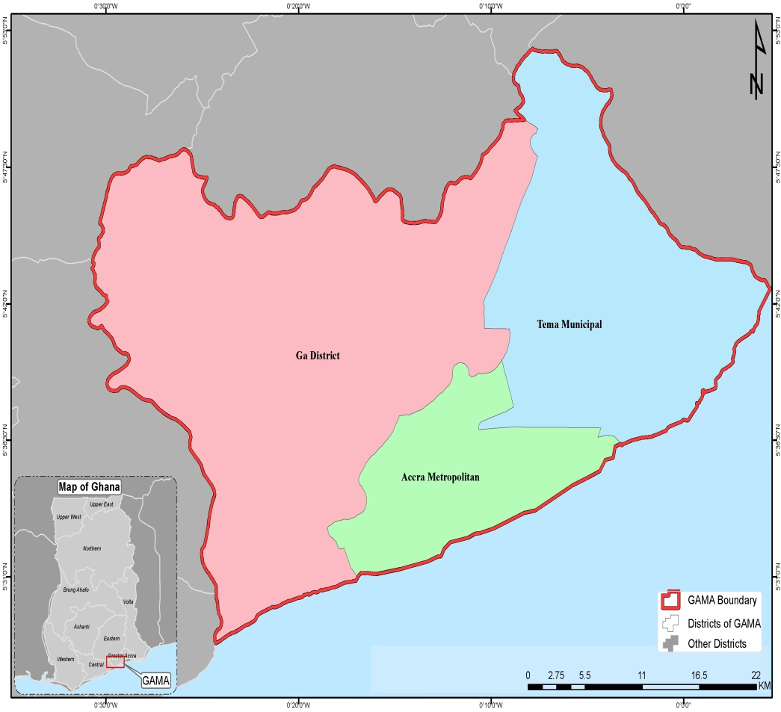
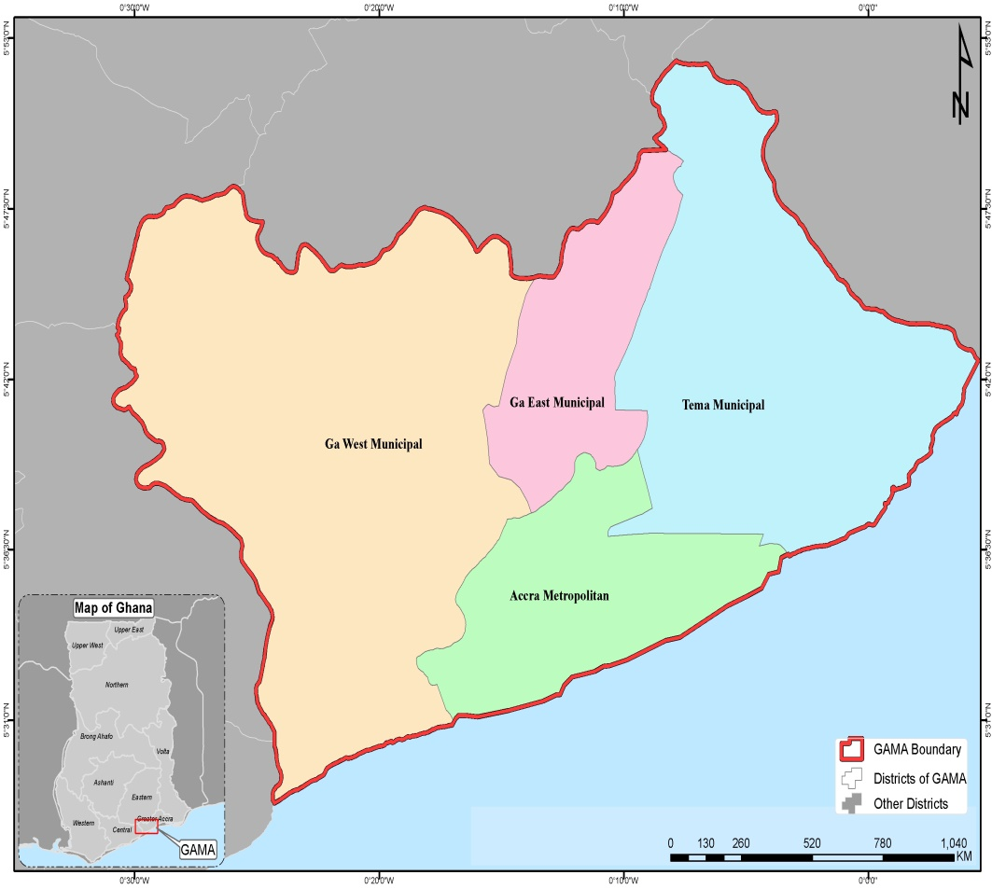
Fig. 1a: MMDA Areas in GAMA, 1988-2003 Fig. 1b: MMDAs in GAMA, 2004-2007

Slide 13
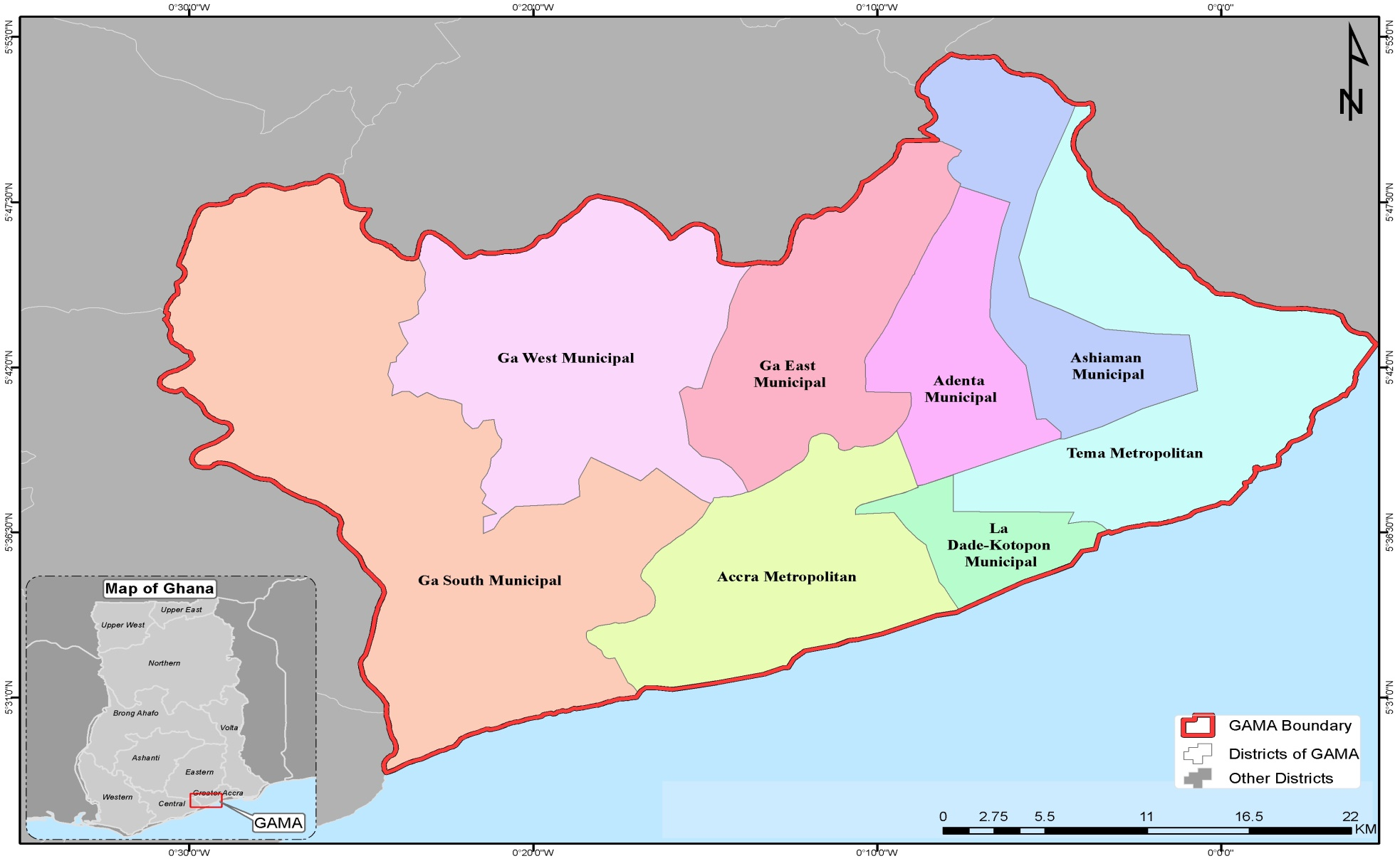
Local Government Areas in GAMA, 2008-2011

Slide 14
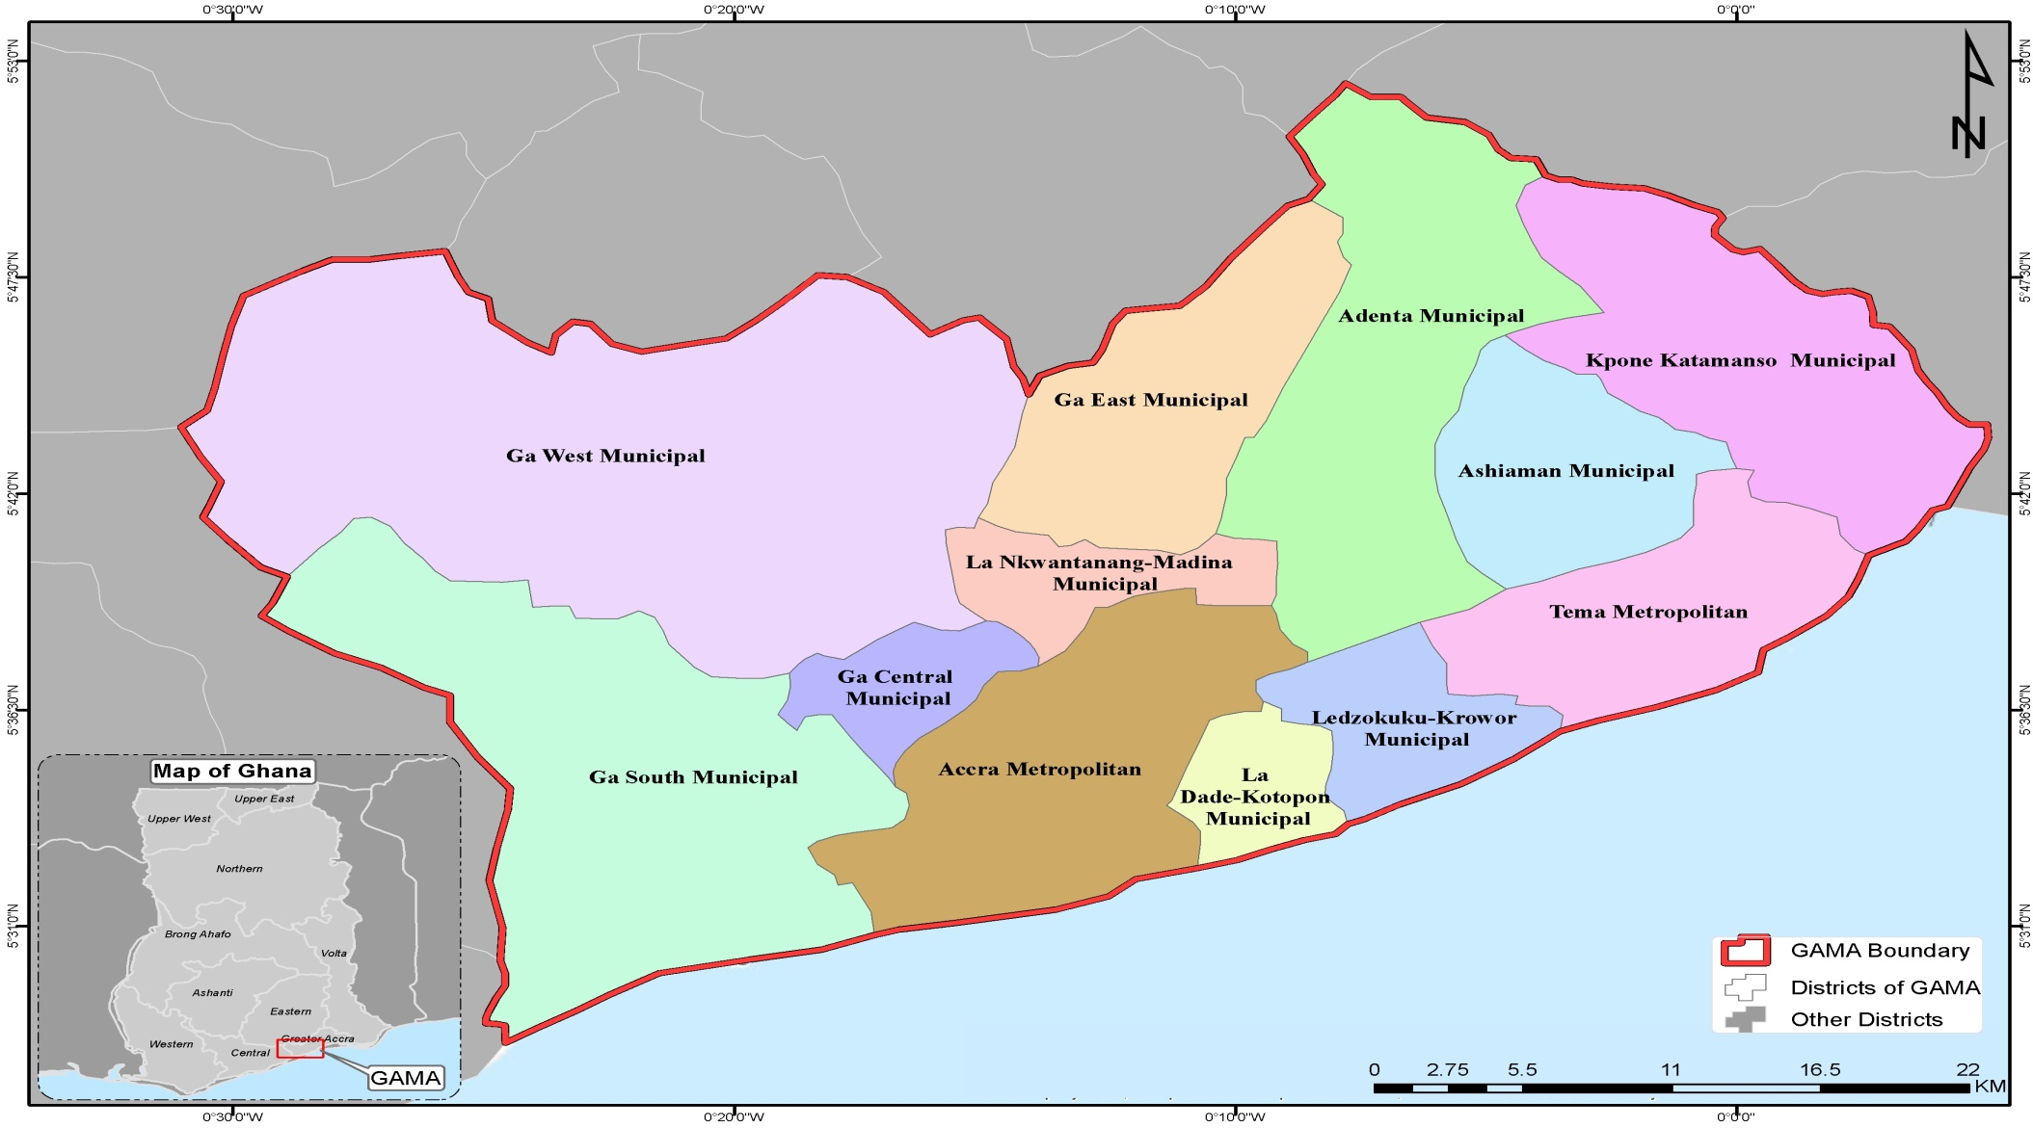
Map of Local Government Areas in GAMA, 2012-2015*
*Boundaries of MMAs on this map do not represent the yet to be gazetted boundaries in GAMA

Slide 15
Municipalities/Local Governments within GAMA, 2018-2019
Name of Assembly | Capital |  | Name of Assembly | Capital
1. Ablekuma North Municipal | Darkuman |  | 14. Ga East Municipal | Abokobi
2. Ablekuma West Municipal | Dansoman |  | 15. Ga West Municipal | Amasaman
3. Ablekuma Central Municipal | Lartebiokorshie |  | 16. Koley Klotey Municipal | Osu
4. Accra Metropolitan | Accra |  | 17. Kpone Katamanso Municipal | Kpone
5. Adentan Municipal | Adenta |  | 18. Krowor Municipal | Nungua
6. Ashaiman Municipal | Ashaiman |  | 19. La Dade-Kotopon Municipal | La
7. Ayawaso East Municipal | Nima |  | 20. La Nkwantanang–Madina Mun. | Madina
8. Ayawaso North Municipal | Accra New Town |  | 21. Ledzokuku Municipal | Teshie
9. Ayawaso West Municipal | Dzorwulu |  | 22. Okaikwei North Municipal | Tesano
10. Ayawaso Central Municipal | Kokomlemle |  | 23. Tema West Municipal | Tema Community 18
11. Ga North Municipal | Ofankor |  | 24. Tema Metropolitan | Tema
12. Ga South Municipal | Ngleshie-Amanfro |  | 25. Weija-Gbawe Municipal | Weija
13. Ga Central Municipal | Sowutuom
Source: Ministry of Local Government & Rural Development, Accra, 2019 (Red indicates LGs which were part of Accra Metro Assembly in 2010)

Slide 16
Conclusion
Restructuring of LG areas in many countries has broadly focused on the enlargement of the scope and reduction in the number of local governments (Meligrana 2005).
This is, however, contrary to the Ghanaian case, where restructuring of local governments within the context of urbanization and globalization has largely involved the fragmentation and creation of new districts in metropolitan regions like GAMA.
Beyond the challenges of fragmentation of large cities/metropolitan areas through the creation of LGs – census data give the impressions of Ghanaian cities experiencing weak in-city migration.

Slide 17
End of Presentation, Thank you

